Slide 1
Mental Health Leads Pastoral Meeting - Autumn 2025
Emotional and Mental Wellbeing in Education (EMWiE) Team

Slide 2
Mental Health Leads Training
Introduction to Mental Health Leads Training (For new MHLs/DMHLs
  Emotional wellbeing and mental health in children and young people
  The roles and responsibilities of a mental health lead in education
  Introduction to Department for Educations Whole School/College Approach to emotional and mental wellbeing and how to embed in your setting
  Staff Wellbeing
  Children & Young Peoples Mental Health Services overview in Hertfordshire
  Practical examples and sharing of good practice
Robertson House sessions, 9.15am to 3.30pm Online sessions, 9.30am to 3pm
Wednesday 19th November FULL Tuesday 3rd March FULL
Wednesday 21st January
To book, email schoolsmh@hertfordshire.gov.uk with your name, role, school and preferred date.

Slide 3
Mental Health Leads Training
Mental Health Leads Refresher Training (if you have not had training in the last two years)
  Staff Wellbeing
  Emotional wellbeing and mental health in children and young people
  Children & Young Peoples Mental Health Services overview in Hertfordshire
  Sharing good practice on Whole School/College Approach to emotional and mental wellbeing
Online sessions, 9.15am to 12.30pm
Tuesday 4th November FULL
Thursday 13th November FULL
Monday 12th January FULL
Tuesday 24th March FULL
To book, email schoolsmh@hertfordshire.gov.uk with your name, role, school and preferred date.

Slide 4
Schools Mark Show and Tell
Thursday 13 November, 1pm to 2.30pm
Education settings are invited to join the EMWiE team for a 90-minute session showcasing some of the fantastic mental health practice witnessed in schools over the last academic year.
Through completing the Emotional Mental Wellbeing in Schools Mark, schools have demonstrated some wonderful examples of good practice, aligning to the eight Department for Education principles outlined in the paper Promoting children and young people’s mental health and wellbeing.
Many of these ideas can be replicated in other settings with no, or very little cost - or even a simple change in thinking and processes.
To join the session, please use this Teams meeting link or email shelley.woods@hertfordshire.gov.uk for the
calendar invitation.

Slide 5
CYPMHS HertsHub Website
Overview
  Launch date imminent – soft launch initially to undertake user testing, followed by widespread marketing campaign to promote during the Autumn term
  Central site for advice, information, and signposting to services – but not a replacement for individual service websites (e.g., HPFT, HCT, HMN)
  Coproduced with CYP - logo and colour scheme developed by Herts CYP
  Clear menus, to aid ease of navigation
  Feedback boxes throughout the site to provide comments, and suggestions for additional content
  Signposting to available professional newsletters and comms resources
  Evolving resource library to ensure we can provide relevant information
  Dedicated resource area for parents and carers

Slide 6


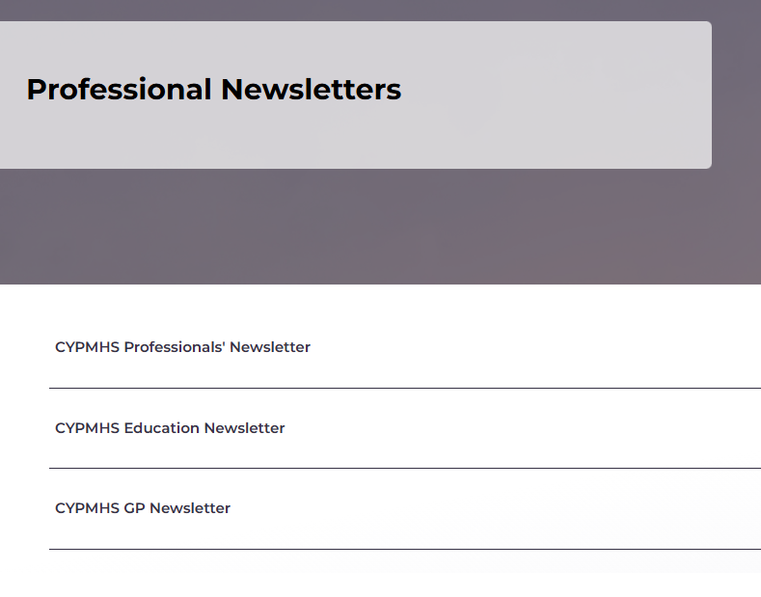
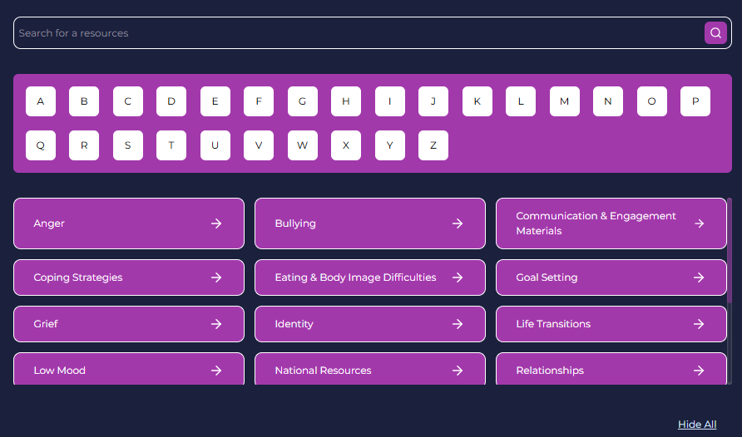



Slide 7
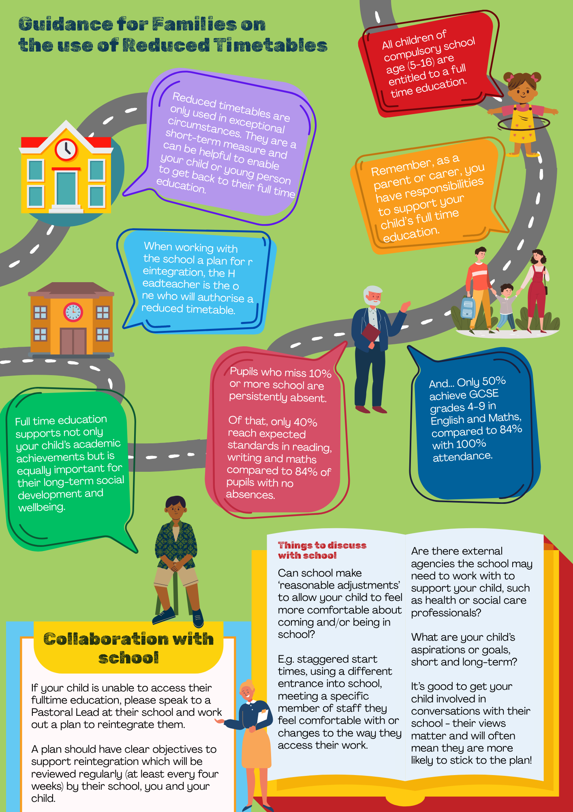

RTT (Reduced Timetable)
Guidance for GPs
Guidance includes:
Statutory responsibilities for schools and parents/carers on full-time education
When RTT can be used
Collaboration with schools
Conversations with families including long term health and educational impacts
Safeguarding concerns
ESMA Support
Template letter to share any supporting information to Headteachers
Parent/carer poster

Slide 8

Emotionally Based School Non-Attendance
(EBSNA) Framework
Launched in June 2025 following pilot with schools in DSPL 6 & 9
https://thegrid.org.uk/assets/ebsna-framework-june2025.pdf
Framework is a proactive, early intervention tool
Triangulates the views of the child, parents/carers and teachers to develop a plan for reintegration – works on push/pull factors
Helps build trusting relationships with a collaborative approach
The questionnaires help ‘widen the lens’ on the situation
Can be used to give a longer-term view of CYP’s goals

Slide 9
Children’s Crisis Assessment and
Treatment Team (C-CATT)
C-CATT (Children’s Crisis Assessment and Treatment Team) is a multi-disciplinary team who provide assessment and short-term intensive interventions for children and young people under 18 years old experiencing a mental health crisis in Hertfordshire.
The team assess CYP in the acute hospitals (Watford & Lister) as well as in the community.
C-CATT offer crisis support via the Crisis Line – available for all Hertfordshire young people, their care-givers and professionals. This is accessed via SPA.
C-CATT operate 24/7.
Notes:
abuse or neglect, including non-recent abuse
mental health problems
conflict within key relationships
drug or alcohol use
bullying
lack of stable or consistent care
social isolation

Slide 10
C-CATT Crisis Call Line: 0800 6444 101
Screened by SPA first, then C-CATT are contacted
* Some cases may not be sent through to C-CATT. CYP may be treated as a referral to SPA and supported by community services or referred to their community team if this is appropriate or clinically indicated.
C-CATT triage call
Offer support over phone
Immediate assessment in A&E
Urgent assessment within 24 hours
Referral to CAMHS for assessment
Signpost to other agencies
Notes:
abuse or neglect, including non-recent abuse
mental health problems
conflict within key relationships
drug or alcohol use
bullying
lack of stable or consistent care
social isolation

Slide 11


Sending CYP to A&E with mental health
concerns
You should only send CYP to A&E if:
They require physical health treatment for overdose/ligature attempt or self-harm that cannot be treated in the community e.g. by GP practice or urgent care.
The CYP is at imminent risk to themselves or others due to a current mental health crisis and/or requires a place of safety.
OR
If you are unsure whether a CYP needs to come to A&E for physical treatment, call 111 for advice.
If you are unsure whether a CYP is at imminent risk, call SPA on 0800 6444 101 for advice.
Notes:
abuse or neglect, including non-recent abuse
mental health problems
conflict within key relationships
drug or alcohol use
bullying
lack of stable or consistent care
social isolation

Slide 12
What happens when a CYP gets to A&E?
Triaged by A&E staff
If CYP self discharges before they are seen by C-CATT, they will be followed up
Physical health treatment dealt with first
Once medically cleared, referral made to C-CATT
C-CATT assess CYP within 4 hours of referral
CYP discharged home with a safety plan and an appointment within 7 days with C-CATT or other CAMHS teams
Admitted to hospital as a place of safety either temporarily for further assessment, or referral to an inpatient unit
Inappropriate referral;
C-CATT will complete a risk assessment and close

Slide 13

Who is notified?
The referrer to SPA*
The CYP’s GP always
The CYP’s social worker if SPA are made aware they have a social worker
There are exceptions re notification around 16 and 17 year olds; this is a judgement call depending on risk; the GP is always informed regardless.
Due to patient confidentiality, the young person’s school will only be notified if their school made the referral to SPA.

