Slide 1
Hertfordshire Valuing SEND
Needs Profiles and Focused Intervention Funding

Slide 2
Katy Alexander
SEND Information, Advice and Guidance Officer
SEND Implementation and Statutory Assessment Team
…and Hertfordshire VSEND delivery lead! katy.alexander@hertfordshire.gov.uk

Slide 3
Valuing SEND | Today’s objectives
When is it useful to complete a profile in VSEND?
How do I make a child profile?
How can I incorporate a profile into APDR and other cycles of school support?
What can I do with the profile?
When are child profiles needed (for assessments, referrals etc)?
How can it support my FIF request?
Notes:
Examples of ways in which schools have used VSEND.

Slide 4
Valuing SEND | When is it useful?
For a CYP with emerging needs – for you to track over time and see whether they have SEND
For pinpointing topics to be used within coaching programmes and monitoring progress / impact
To facilitate discussion and understanding with a parent who is beginning to accept their child’s needs
For transition between settings (new transition tool to map onto Setting Readiness)
Where a student’s needs are changing and provision is no longer working (often happens about Y4 and Y9!)
To provide clear, measurable impact at the start / middle / end of provision, including impact of provision
To ensure alignment of needs with the provision provided within targeted interventions
To facilitate a co-ordinated multi-agency approach, ensuring alignment and shared understanding from the start
Notes:
Examples of ways in which schools have used VSEND.

Slide 5
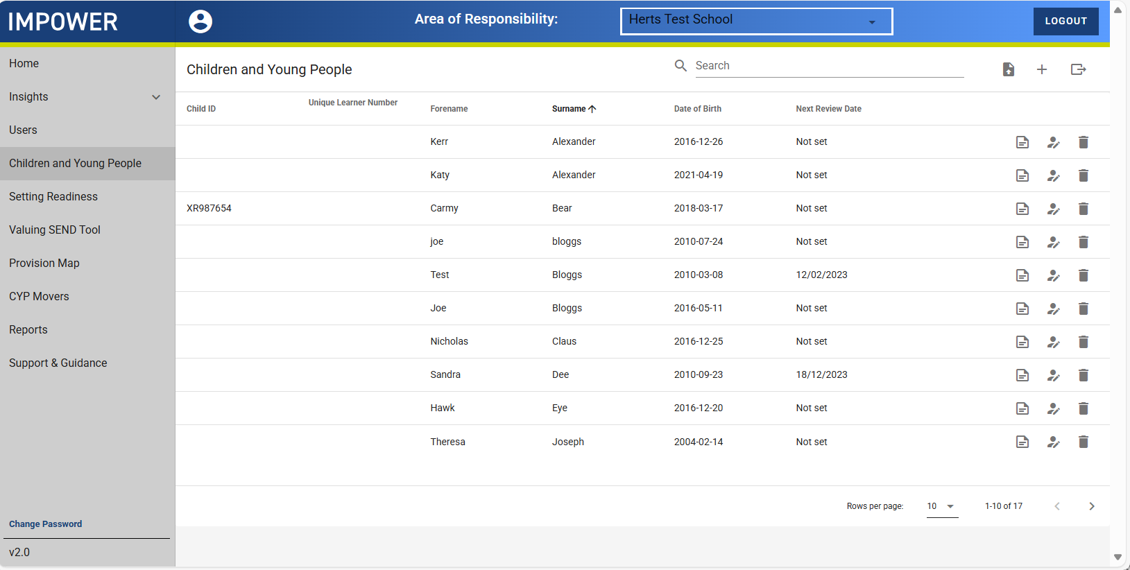
Valuing SEND | How do I make a profile?
Create a new CYP record here
Edit an existing CYP profile here
Amend the CYP’s basic information here, e.g. name, year group, gender, SEN status
Notes:
SENDIAGO (Katy/Latoya/Sarah/Su)
Local Authority Administrators can see anonymous aggregated data for a setting, i.e. the average score for all CYP with a profile – there is no way of identifying any individuals
Could ask: how would us seeing this data be useful for you, as settings? What would be most useful for you as an outcome?

Slide 6
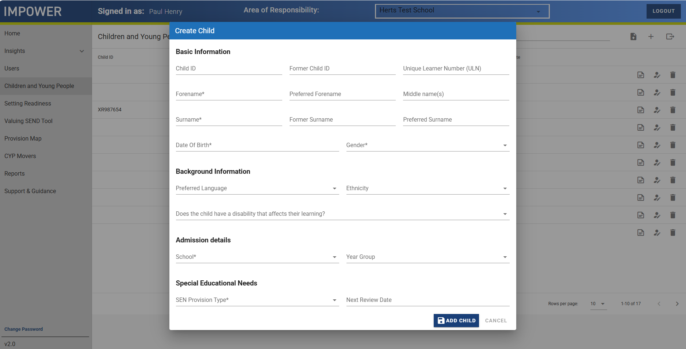
Valuing SEND | How do I make a profile?
Include the UPN where relevant
Pretty standard pupil information form.
VSEND is standalone; profiles cannot be imported from other schools or platforms such as CPOMS/Arbor.
Click ADD CHILD
Notes:
Needs descriptors
The CYP’s needs profile
Can be completed wholly or in part by anyone – in line with good practice, the SENCO should have oversight of all pupils on the SEND register, and teachers should have oversight of all CYP in their class/subject
Done through prompts, which you click and rate the level of need
Brings together all the assessments you’ve completed for a CYP
Can be used as APDR for the pupils for whom you create a profile, if you wish
Does not need to be done if you are successfully using something else, such as Provision Map, which does the same thing! (Provision Map doesn’t do Setting Readiness or Home Confidence so you can still use those parts of the tool)

Slide 7
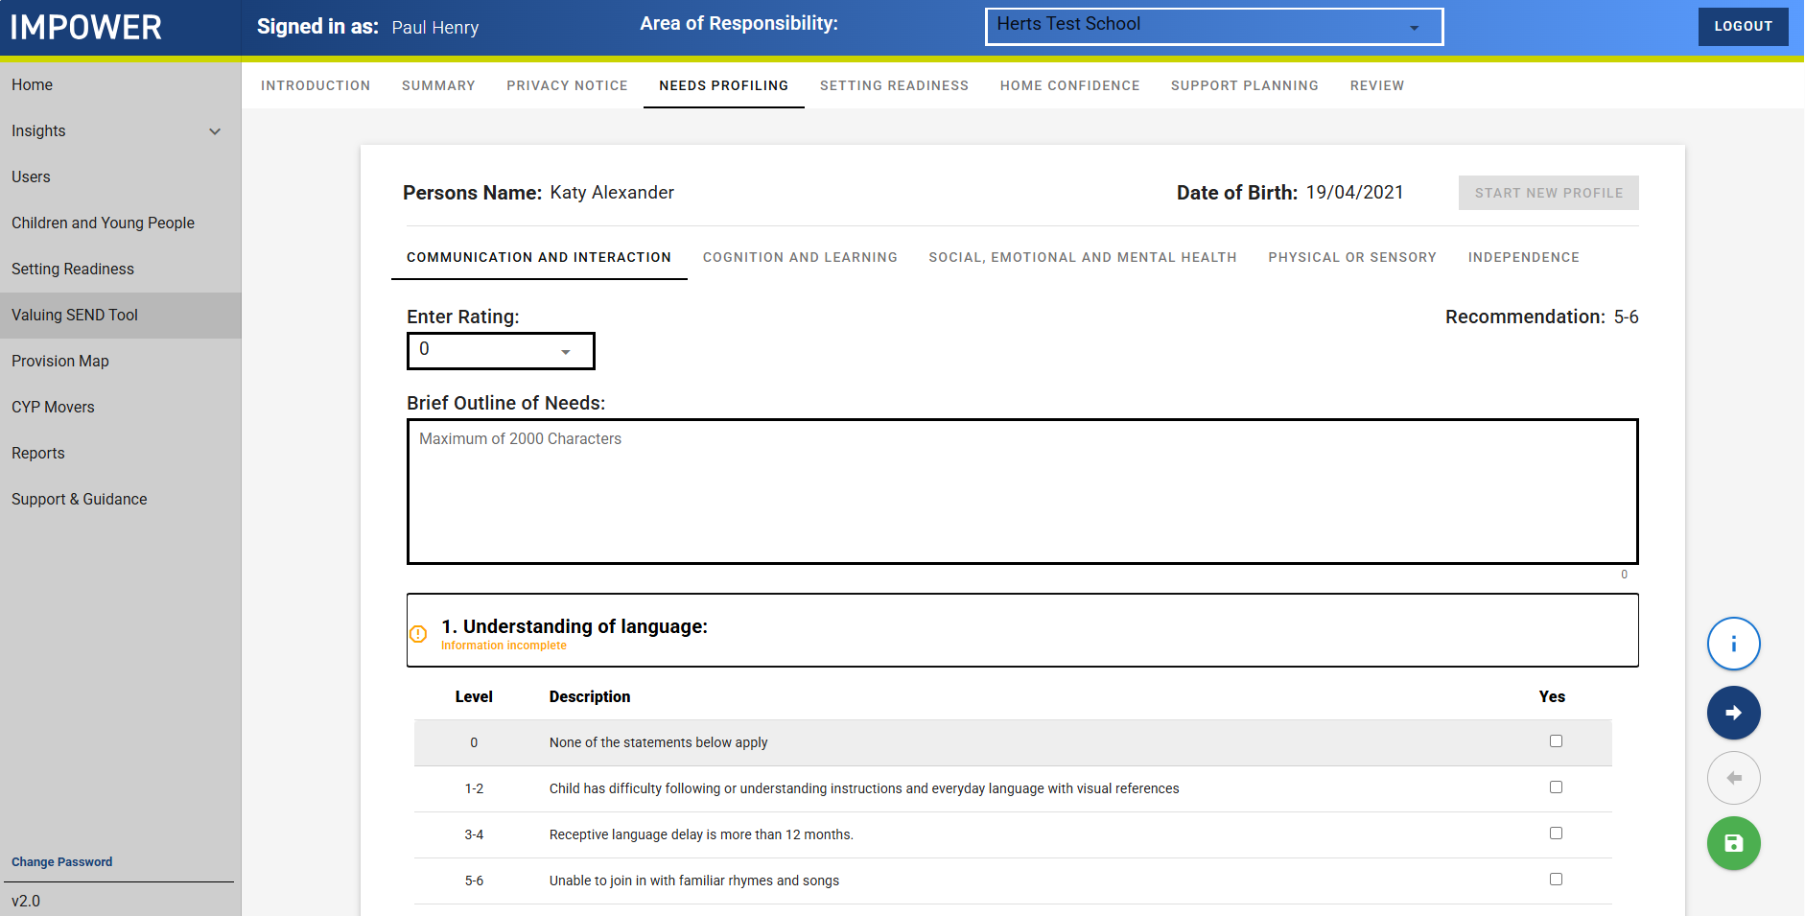
A look at the VSEND tool: CYP profiles
Click through each of the 5 domains in turn
Use the forward and back navigation buttons to move through each section
In this box, you can outline anything relevant to the CYP, e.g. their class has a highly trained SLCN member of staff, as this may not be reflected in the ‘best fit’ Setting Readiness
Click the “i” for guidance notes
Notes:
SENDIAGO (Katy/Latoya/Sarah/Su)
Needs descriptors
The CYP’s needs profile
Can be completed wholly or in part by anyone – in line with good practice, the SENCO should have oversight of all pupils on the SEND register, and teachers should have oversight of all CYP in their class/subject
Done through prompts, which you click and rate the level of need
Brings together all the assessments you’ve completed for a CYP

Slide 8
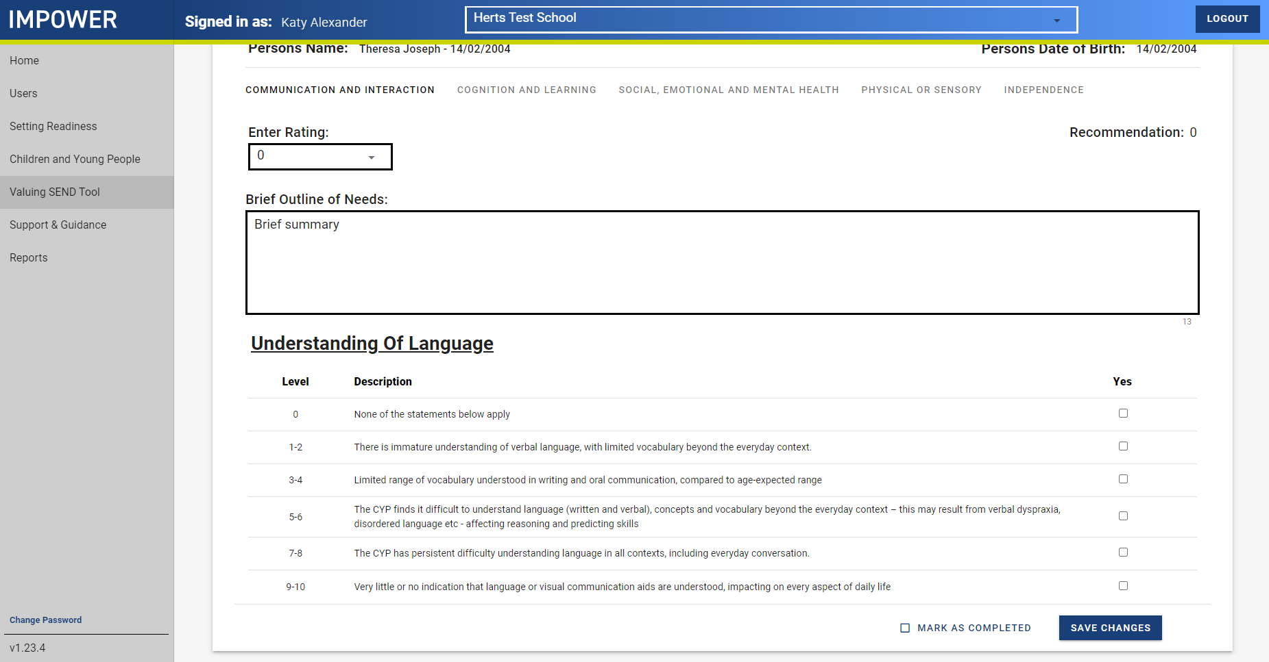
A look at the VSEND tool: CYP profiles
The tool displays one prompt at a time for easy navigation
Read the prompts and decide which most closely resembles the needs with which the CYP presents
Notes:
SENDIAGO (Katy/Latoya/Sarah/Su)

Slide 9
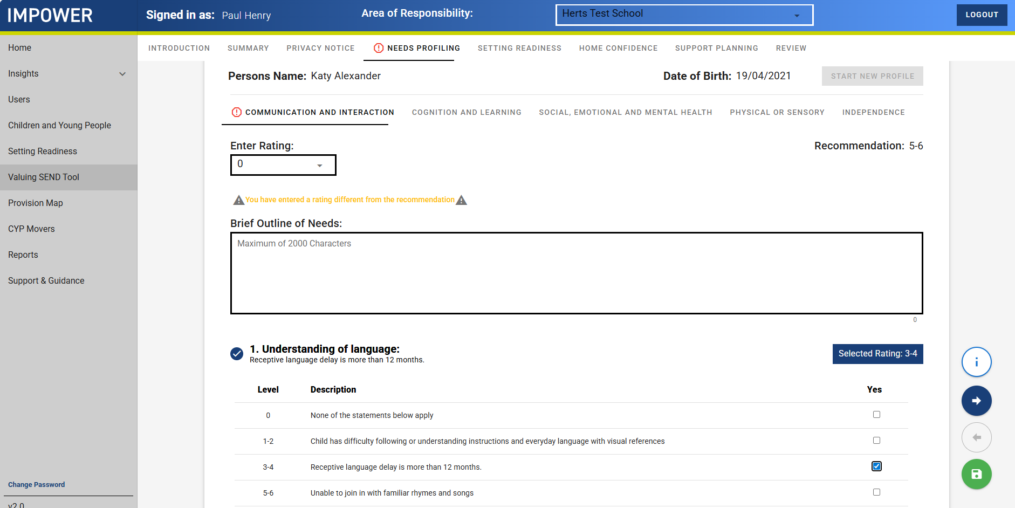
A look at the VSEND tool: CYP profiles
Warning symbols highlight when you have edited a profile, but not yet saved
Once you have selected a rating, that prompt and the Selected Rating is highlighted. Click the navigation button (right arrow) to move to the next one
Notes:
SENDIAGO (Katy/Latoya/Sarah/Su)

Slide 10
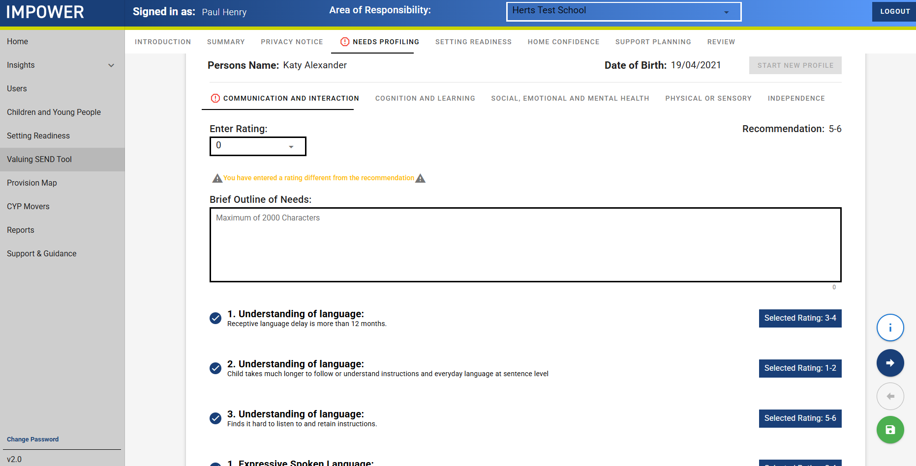
A look at the VSEND tool: CYP profiles
Click through each of the domains in turn, completing the assessments and providing ratings for the CYP
The tool uses your assessments to provide a recommended overall ‘best fit’ rating for each domain.
Add your perspective from the drop down on the left
When you finish, remember to click save and ‘Save as complete’!
Notes:
SENDIAGO (Katy/Latoya/Sarah/Su)

Slide 11
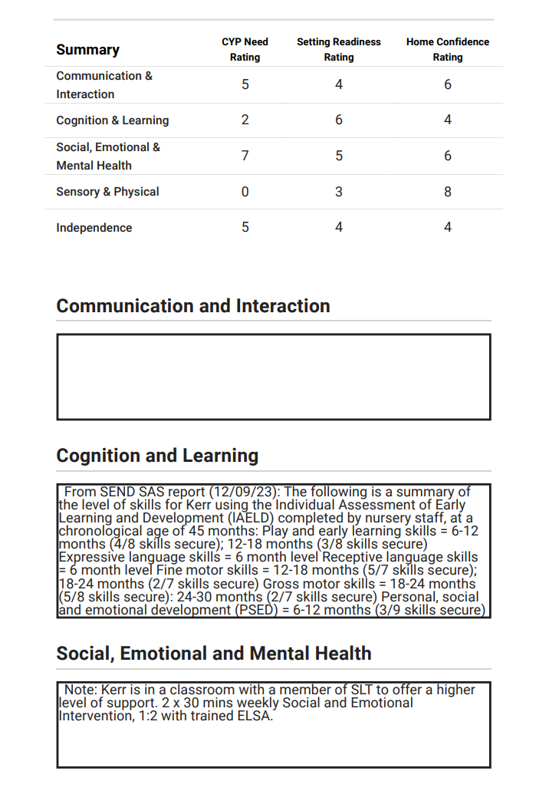
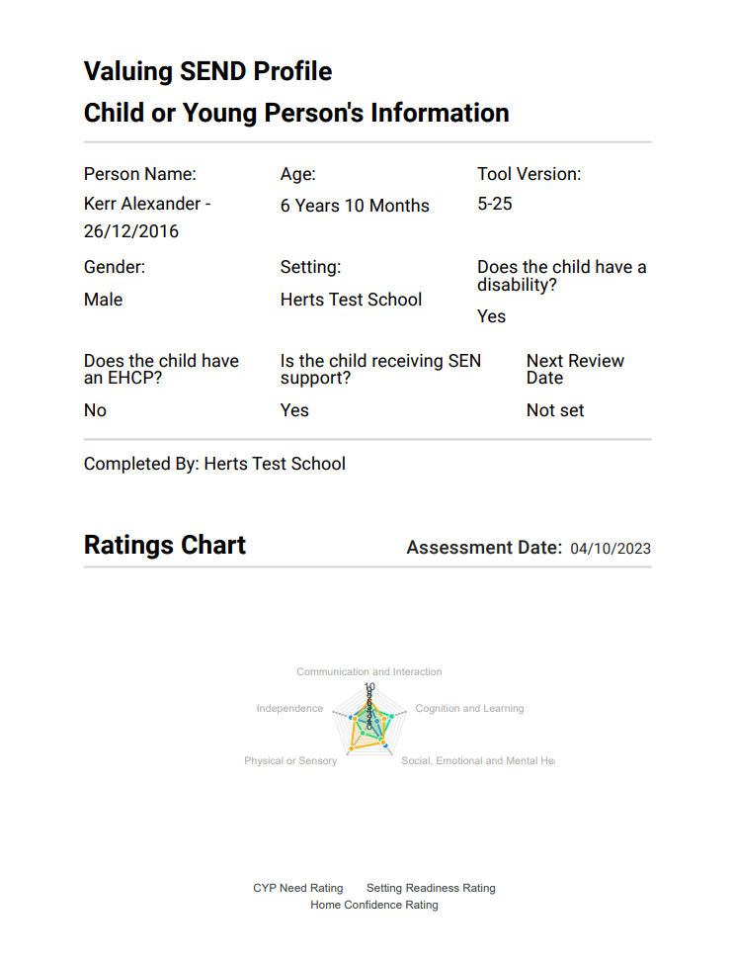
A published pupil profile
How are professionals working together to address areas of highest need?
General overview of the young person
Ratings numbers, in case the radar is too hard to read!
Have there been any missed opportunities for assessment or intervention?
More specific information, including key points from reports / assessments
The radar, showing a holistic view of provision available and the young person’s needs at a glance
Look at how the different areas interplay with each other – what does this tell you?

Slide 12
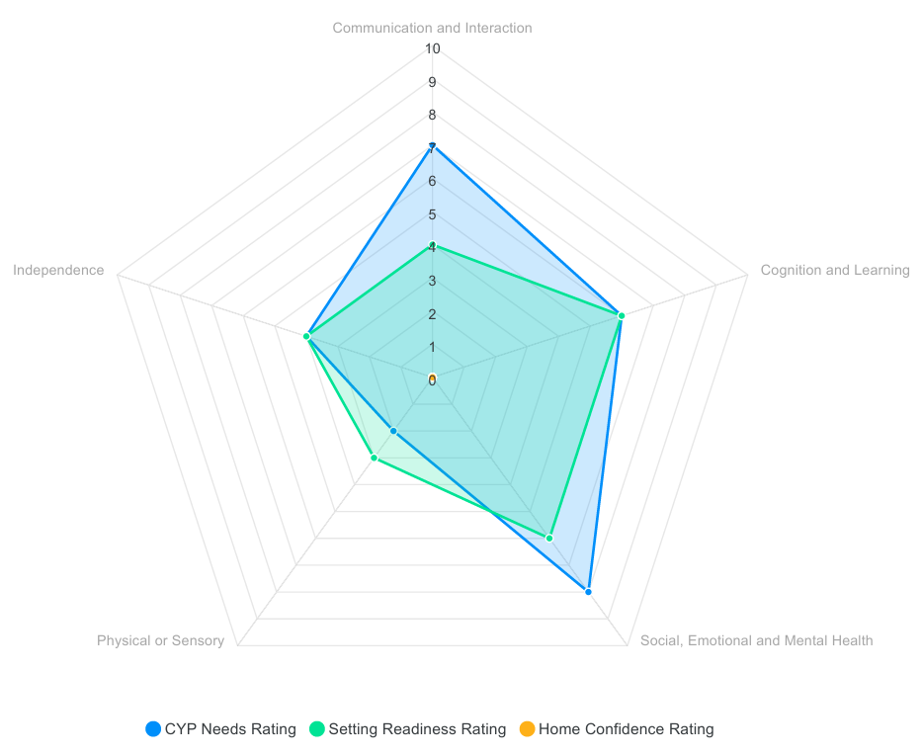
Tracking impact
“Please explain what the challenges are for the young person as result of their needs and the barriers they present for the child. Alongside the radar and profile / assessment information include details of how the needs impact on the curriculum and, if appropriate, upon access to the school and classroom”
Communication and Interaction
Carmy has language processing and auditory working memory difficulties extended verbal explanations are difficult for him as he loses track of what is being said. His English vocabulary knowledge is below average, and he struggles with word-finding. Carmy seems to find it easier to process language when not making direct eye contact; he sometimes closes his eyes when listening.
Cognition and Learning
His language difficulties impact on every aspect of his cognition and learning. In school assessments (carried out Apr 2026) place him at between 0.1st and 5th percentile for most areas. Carmy needs time to organise his ideas. He is able to grasp pattern-finding, and can remember steps in short, specific types of problems; Carmy struggles with spatial aspects of maths.
Social, Emotional and Mental Health
Carmy has a diagnosis of ADHD (since 2021). He enjoys attention from adults and can initate interaction with peers, although cannot always sustain this in an appropriate way, becoming overwhelmed, 'silly', challenging behaviour. Carmy displays violence when dysregulated. Triggers include finding something challenging, being told 'no' in a direct way - these stem from anxieties.

Slide 13
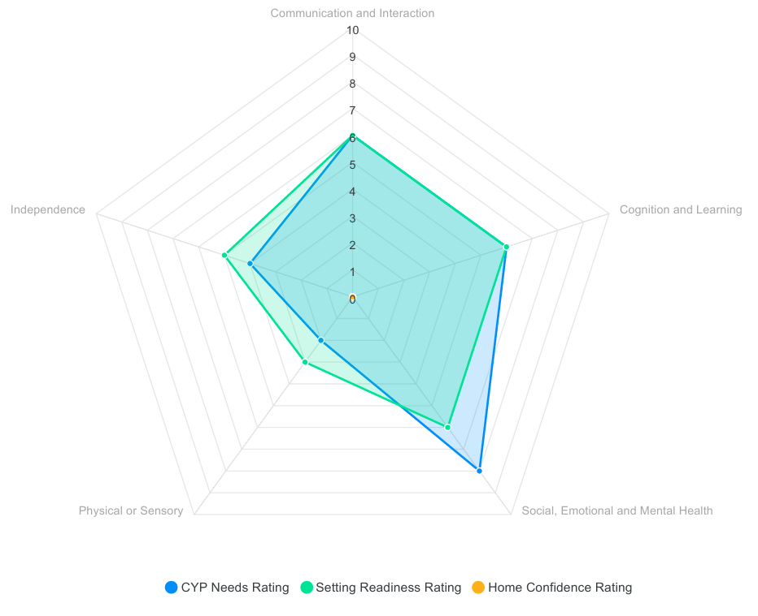
Tracking impact
“How will you know that the intervention has been effective? There needs to be a measurable impact provided so that this can be assessed during and at the end of the funding period.”
Communication and Interaction
Carmy has language processing and auditory working memory difficulties - intervention has supported his tracking of extended verbal explanations, although they still provide a challenge. His English vocabulary knowledge is below average, and he struggles with word-finding; Word Aware has supported his strategies for this. Carmy seems to find it easier to process language when not making direct eye contact; he sometimes closes his eyes when listening.
Cognition and Learning
His language difficulties impact on every aspect of his cognition and learning. In-school assessments (carried out July 2026) place him at between 0.1st and 5th percentile for most areas. Carmy needs time to organise his ideas and is slowly becoming independent with graphic organiser strategies. He is able to grasp pattern-finding, and can remember steps in short, specific types of problems - although this is improving slowly. Carmy continues to struggle with spatial aspects of maths.
Social, Emotional and Mental Health
Carmy has a diagnosis of ADHD (since 2021). He enjoys attention from adults and can initiate interaction with peers. Following some intensive intervention, he is increasingly able to sustain interactions in a prosocial way. He does still become overwhelmed and displays challenging behaviour with certain peers or when he is already tired / overwhelmed. Carmy displays violence when dysregulated, although he now aims this at objects rather than people. Triggers include finding something challenging, being told 'no' in a direct way - these stem from anxieties. Note that his level of need is still at 8, but some of his individual prompts have moved 'down' in severity of presentation.
Independence
Carmy has made progress, and is becoming increasingly able to display some age-related independence skills. He still needs scaffolding and adult prompting for most of these.

Slide 14
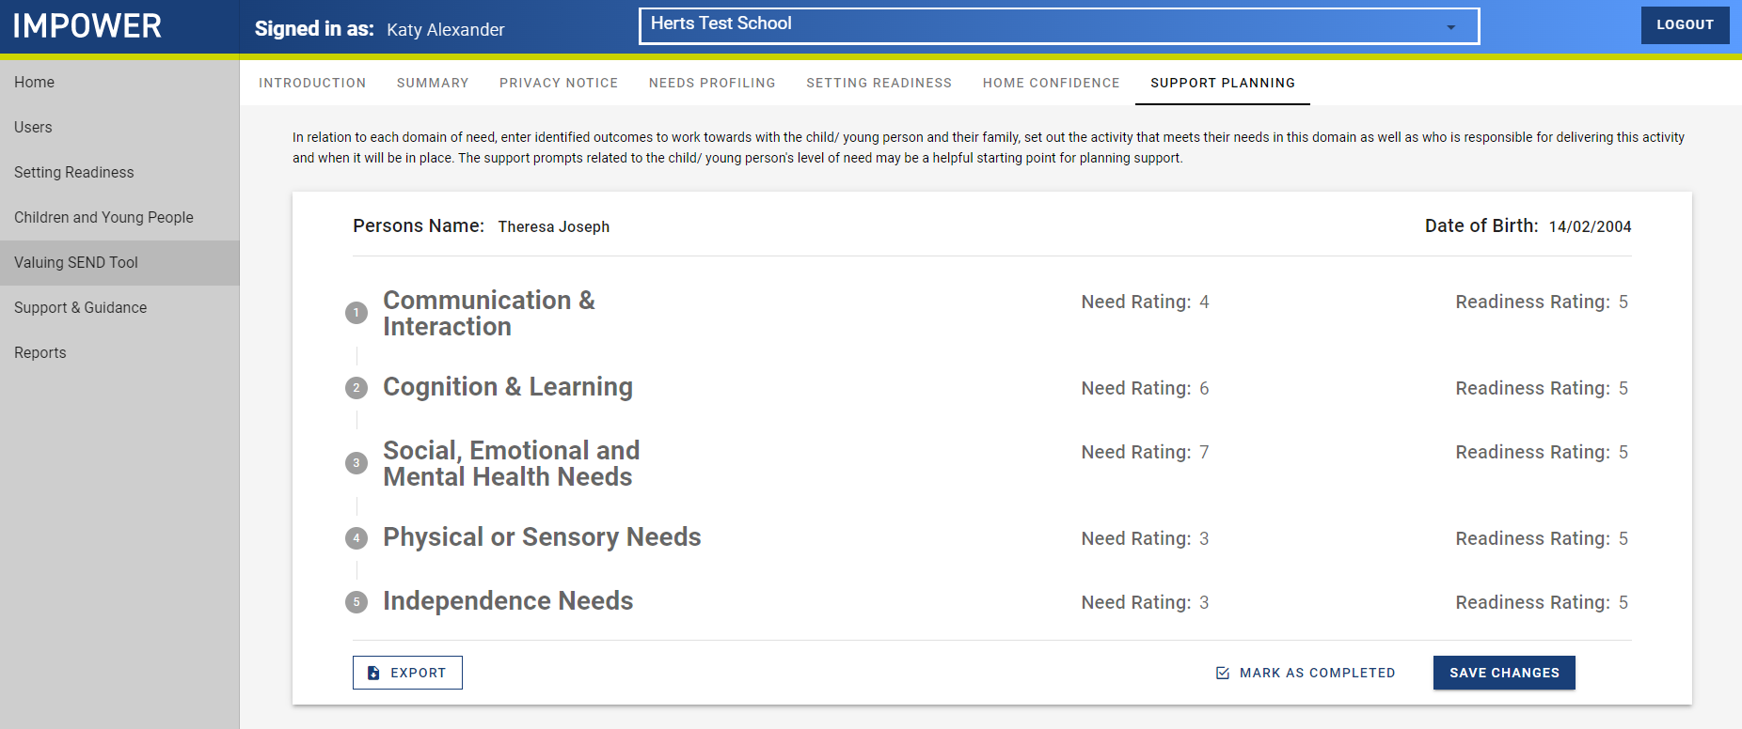
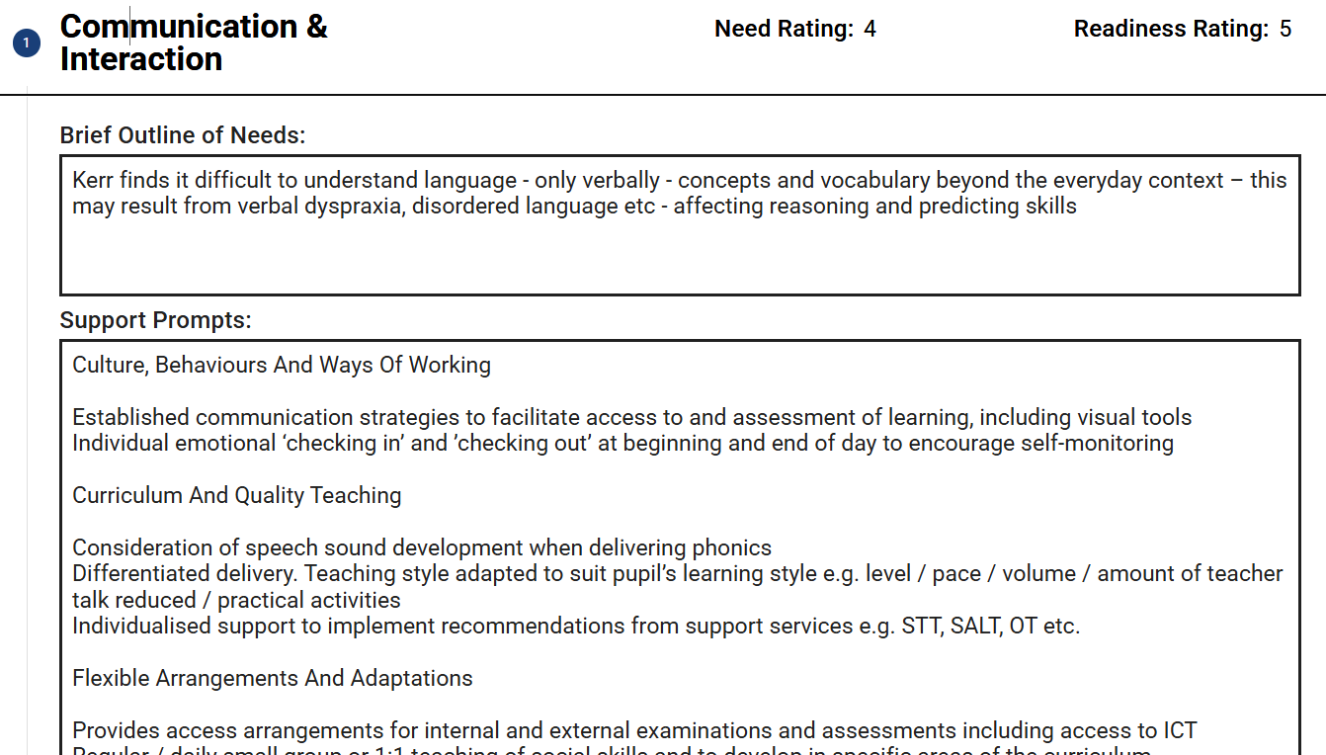
A look at the VSEND tool: Support Planning
This can be accessed once all the Needs Ratings and Setting Readiness Ratings are completed
This provides ideas for SENCOs to recommend, for class teachers to access independently and implement into their practice, and for any teachers or TAs involved in interventions to find ideas for strategies
This may also highlight where the SENCO (or other relevant staff) needs to deliver training, e.g. on how to use social stories
Note: there is no expectation that EVERY strategy will be implemented! This is a guide to be used alongside the SENCO’s professional judgement
Notes:
Support planning
Creates prompts and suggested strategies based on what has been inputted for each CYP
This can be shared with teachers, TAs, families
Can provide a basis for multi-disciplinary discussions, e.g. when calling advice lines or speaking with health professionals
Is the section where you can use VSEND as APDR (see next slide)

Slide 15
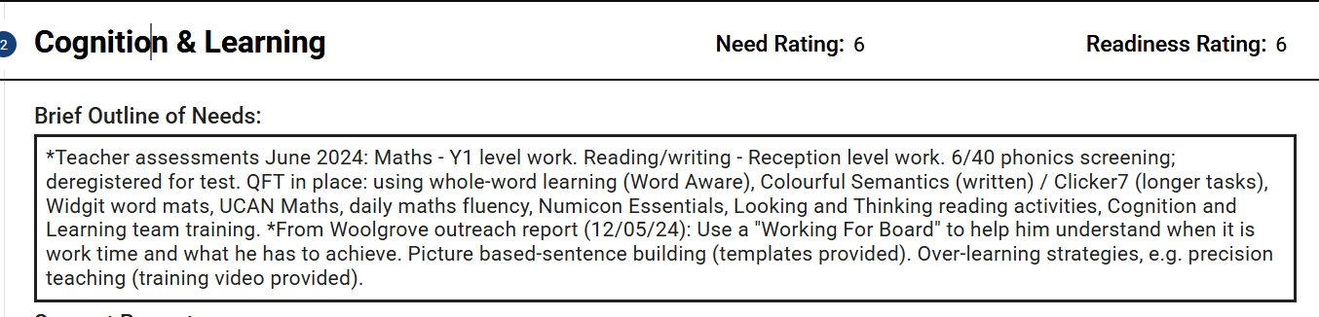
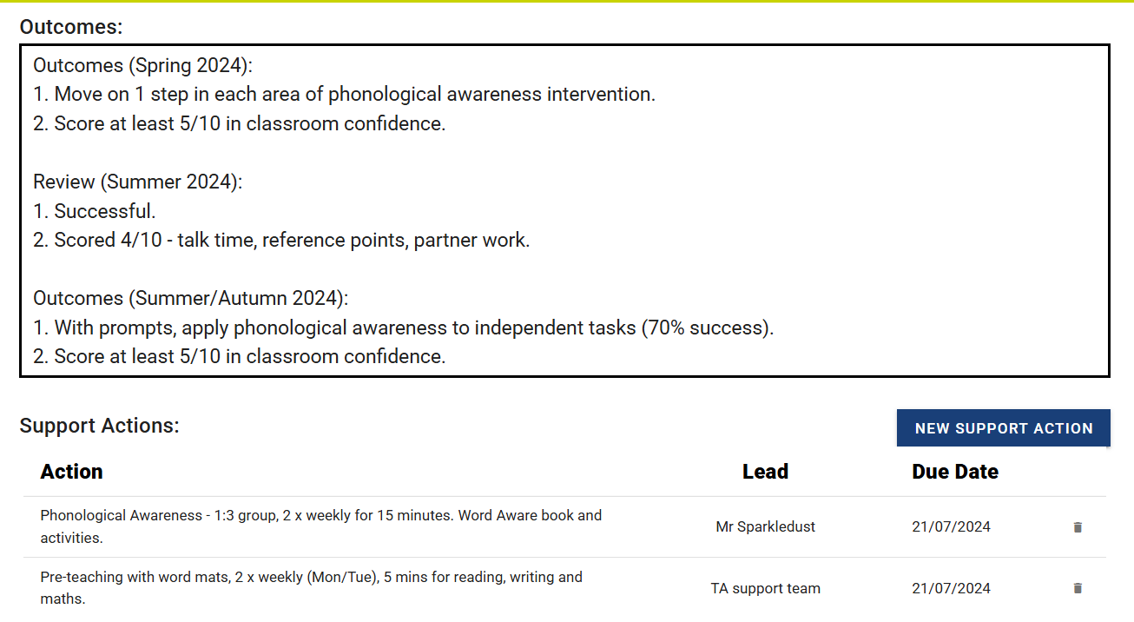
Support Planning: additional things you can do
Copy and paste from reports and assessments / interventions
Review the provision implemented
Log support actions – these can be copied and pasted from reports, assessments or from the auto-populated Support Prompts box
Notes:
This is how you could use VSEND as your APDR for the CYP you have profiles for. (There is a profile, Kerr Alexander, on the Herts Test School site that has a few cycles of APDR logged on there if you wanted to show a live demonstration – or feel free to make your own!)

Slide 16
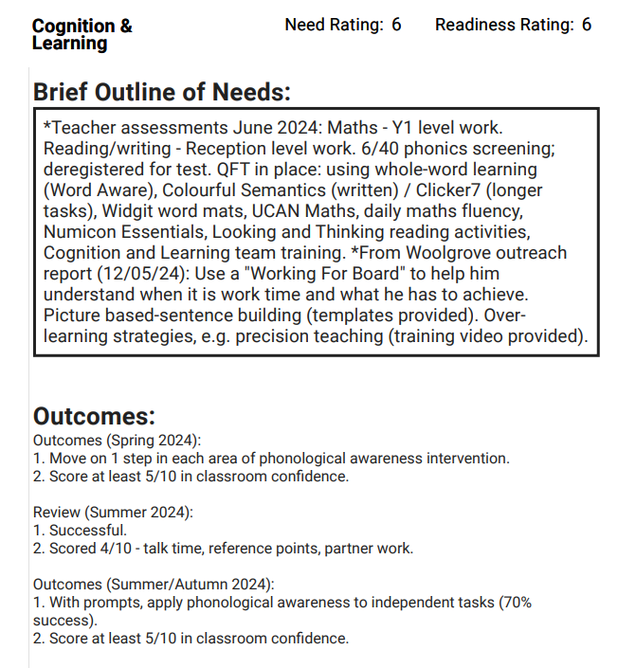
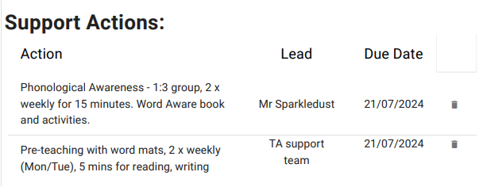
Support plan
example
Headlines for the main areas of need
Are these the most appropriate assessments? What is in place in the classroom?
Space for the setting to log Plan and Review
Have you reviewed provision? What has been your response to this?
Are these the most suitable interventions? How does this look day-to-day?
Details of any interventions in place

Slide 17
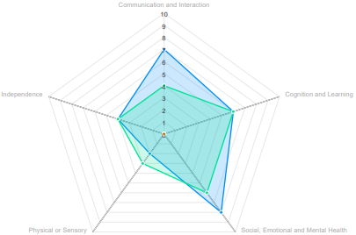
Valuing SEND | Case study example
Valuing SEND helps parents develop an understanding of their child’s needs, as well as highlighting the ways in which his needs in different areas interact with one another.
CYP needs
Setting readiness
Home confidence
SITUATION – Carmy is a 7-year-old on SEN support in a mainstream primary school. His parents are becoming more open to the idea that he needs further support and that his presentation at school is placing him at risk of suspension.
VALUING SEND – There is a clear interplay between his C&I needs and his SEMH needs, which are, in turn, impacting upon his ability to engage in learning. The radar helped school identify this interplay between Carmy’s needs, and consider appropriate interventions to work towards better progress in key areas.
ACTIONS / IMPACT – The radar allowed school to clearly exemplify to parents Carmy’s presentation at school; they co-produced a support plan through a structured conversation. Areas for improvement were identified within C&I, and SEND SAS were engaged in offering ideas for CPD. An appropriate intervention was found and purchased using FIF. The radar will be updated in a term’s time to track progress in both Carmy’s presentation and the school’s readiness to meet his needs.
Domains of Need | CYP needs | Setting readiness
1. Communication & Interaction | 7 | 4
2. Cognition & Learning | 6 | 6
3. Social, Emotional & Mental Health | 8 | 6
4. Sensory & Physical | 2 | 3
5. Independence | 4 | 4
This really helped Carmy’s parents understand the realities of how he is presenting at school, and also gave my teaching staff a more robust understanding of how it all ties together. We were all able to move things forward together, with everyone on the same side.
Notes:
If preferred, these case studies could be sent out in advance for attendees to consider and discuss at the refresher session.

Slide 18
Valuing SEND | Next steps
  Use VSEND to problem-solve – not all the children on your SEND register need to be added, this is for those “head scratcher” cases
  Consider around 3 children each term to be used for VSEND you can call Ask SALI / your SISO to discuss individual cases
  Identify key points from Setting Readiness to be used within your School Improvement Plan or CPD programme
Contact details:
If you have any questions or queries please contact vsend@hertfordshire.gov.uk
For any technical issues please contact the Unify helpdesk at support@unifybusiness.co.uk

