Slide 1










Emotionally-based school non-attendance: a framework for schools
Schools briefings
17/06/25
18/06/25
23/06/25
25/06/25

Slide 2

Outline
What is EBSNA?
Context and development
How does the Framework help?
Key messages
Impact – real life example
Hertfordshire County Council
Notes:
Briefing will emphasise the importance of how you use approaches as much as what you do, as this is key in this area, which can be emotive for both parents and school staff.

Slide 3

What is EBSNA?
Umbrella term used to describe a group of CYP who experience significant and enduring challenges in attending school due to emotional factors
More than a young persons perceived dislike for school
Rooted in emotional and physical distress that can escalate to an extent that the child or young person does not feel able to attend school at all
Hertfordshire County Council
Notes:
Previously term used was EBSA – emotionally-based school avoidance , but this implies that there is choice/control over not being in school, which is not always the case. Some CYP want to be at school.
We don’t want to locate the problem with the child or YP.
Everyone experiences anxiety and often anxiety is a healthy and helpful response to a situation. People feel anxious when they believe they are under threat. When someone thinks something bad is going to happen, their bodies release adrenaline which helps them physically prepare to deal with the threat by running away or fighting.
Sometimes we think situations are dangerous when they are not and, because we think we are in danger, our body produces adrenaline. When we feel anxious sensations in our bodies, it is natural to want to avoid the triggering situation. However, every time we avoid the thing that we are worried about, it reinforces the belief that we need to avoid it to make ourselves feel safe. We do not get the chance to learn that we are able to cope or that the situation is as bad as we think it will be.

Slide 4
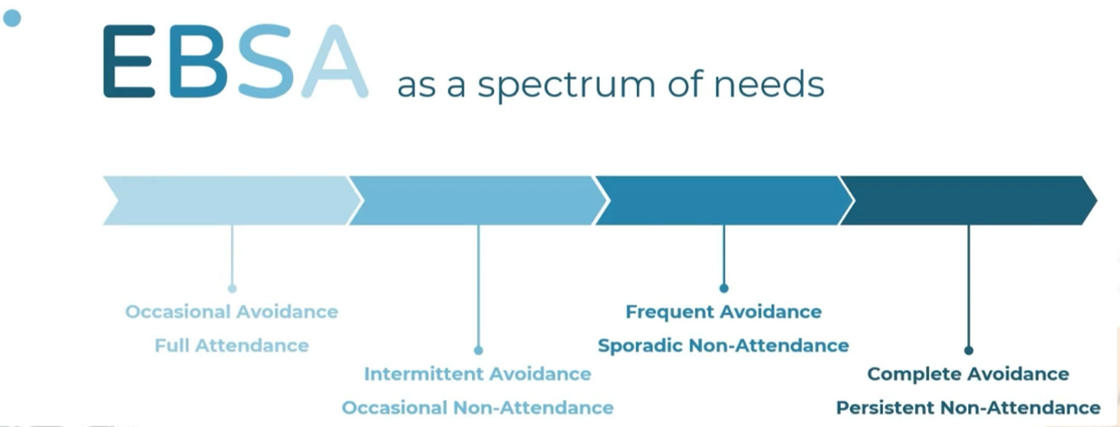
EBSNA
- Happens for many different reasons
- Has increased since Lockdown
- Can be experienced while the child is still attending school
- Is a spectrum of needs
Hertfordshire County Council
Notes:
Many factors can contribute towards EBSNA, and often it is more than one. Happens for lots of different reasons. Each child, family and school context is different and for that reason, each situation will need an individual response.
Early intervention is important . It’s harder to move things on when children have been out of school for long periods of time.

Slide 5


Context
Builds on EBSA guidance produced in 2021 by EPS
following Lockdown
Topical issue, widely reported
Practical support for schools
Produced collaboratively
Consultation and pilot feedback informed
content
School feedback schools Autumn term
Sent to all schools
Located: Grid for Learning and Local Offer
Hertfordshire County Council
Notes:
We thought that something more practical was required, (since ‘EBSA guidance for schools’ produced in 2021), especially to reinforce what recent research has shown us – and that is that a relational approach is key to finding a way forward
Topical issue, often bound up in tricky emotions.
New EBSNA Framework produced by EPS – thanks to EP team and thanks to DSPL 6 and 9 leads – Cheryl Mence and Gemma Hall. The Inclusion and Access Team first approached the EPS about developing this.
Produced in collaboration with other LA services, including the access to education team. Thanks to the Emotional Wellbeing in Schools team, the Attendance team and Herts Parents and Carers Involvement– (HPCI) Herts Parent Forum who all had input.
Will be reviewed in the Autumn term. Shared now, so schools can take a look with a view to perhaps using it in the Autumn term. We would be interested in hearing any success stories.
Available on Schools Grid for Herts SEND Local Offer.

Slide 6
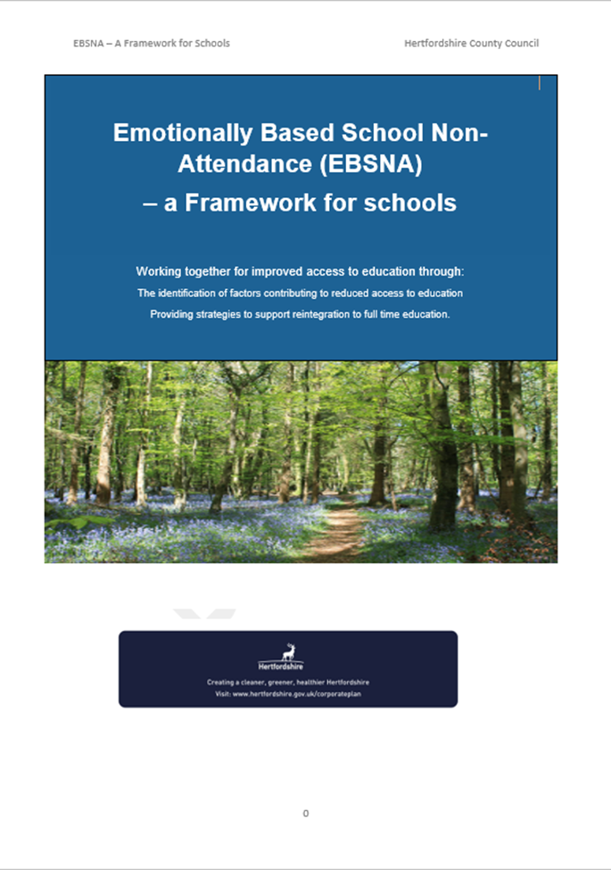
EBSNA Framework
Guidance for schools – not statutory.
An exploratory tool that supports a structured approach to
addressing low attendance, identifying the
contributory factors, using a targeted approach.
Provides clarity for everyone about what is being
tried and what is working – hopefully supports the
good practice that is already in place.
For early stages of reduced attendance (usually..).
For any CYP, as is an individualised approach.
Hertfordshire County Council
Notes:
This Framework has the status of guidance. It is based on good practice, guided by research in this area which is continually taking place.
It enables schools to have a record of what has been planned and progress. Helpful for school, parents, (the YP) the LA, etc. (Ofsted…).
Aimed to be used at early stages of reduced attendance, but always worth a look in any scenario.
Is for any CYP, whatever their needs, as is bespoke.
Contains helpful strategies, resources, suggested provision and links to relevant websites.

Slide 7




Approach
1. Information gathering
2. Action Planning
3. Support
4. Review
Hertfordshire County Council
Notes:
4 stages - should be familiar, as follows Assess, Plan, Do, Review cycle.
1.Information gathering – form CYP, form Parent/carer and from school staff
2.Action planning should involve realistic actions that can be maintained.
3.Support – who is doing what, when and how. Needs to be do-able. (eg back up if key member of staff not available).
4.Review is particularly important as sustaining a momentum of moving forward is key.

Slide 8
Exploration
Explain with parents (and YP) approach being used. Introduce the Framework.
Information Gathering – exploring factors using :
The young person’s form
The parent/carers form
The school’s form
The start of a conversation. Questions to be used flexibly.
Approach is key (see guidance for running effective meetings)
Hertfordshire County Council
Notes:
Gathering info.
See guidance for running effective mtgs. A positive start can set the tone from the start and help to build a trusting relationship.
Info from YP. NB: Framework contains resources that can be used to gain CYP’s views that are for younger children or those who are functioning at a lower level.
May be differences between the views of what the issues are between the parent and the YP. This is fine – there cannot always be consensus.
School, info should be completed last
To be used flexibly – skip over any questions that are not applicable. Questions can be used as an aide memoire. Can tease out issues further.
The start of a conversation

Slide 9

Action Planning
To share what the main factors seem to be and agree what actions will be taken. Has to be collaborative
Important to fix review date
Sensitivity and compassion
Hertfordshire County Council
Notes:
If there doesn’t seem to be agreement about the importance of attending school – helpful to discuss broader aspirations and opportunities that being at school can help to achieve. (Not just about exams – see input from The Reach Free School SENCo – ‘widening the lens’).
Some parents find the school environment a difficult place to be.

Slide 10

Steps to success
Introduce this structured approach with YP and parent sensitively
Early intervention
Individualised
Collaboration and communication
Compassionate, relational approaches work
Approaches that are consistent and sustained
Building on strengths
Hertfordshire County Council
Notes:
Designed for early stages of attendance dropping off – but… worth a look even for entrenched EBSNA, as the push and pull factors change over time.
Bespoke – has to be.. (see Running effective meeting with parents).
Won’t work if not able to sustain a trusting effective relationship with parents
it’s how you do something as much as what you do. Compassion – (eg if it seems as if a parent is not valuing education, there will be a reason for this. What was their own school experience like..?)
Focus on longer term - school is for building skills for life.

Slide 11


How it can work
Laura Juniper
SENCo, the Reach Free School Rickmansworth
Hertfordshire County Council
Notes:
Regular reviews to sustain momentum is important.
Parents responded well to structured approach. Felt contained.
Success stories.

Slide 12






